Slide 1
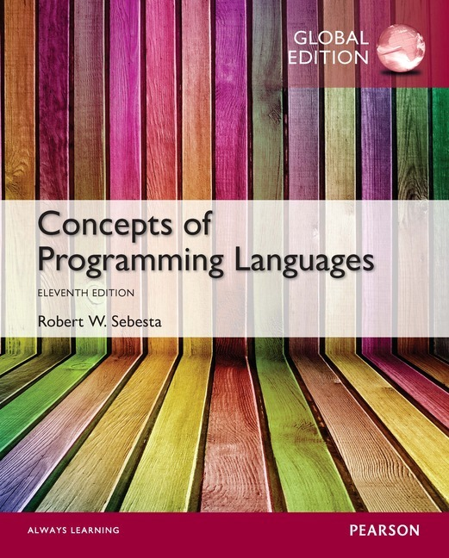
Chapter 1 Part 1
Preliminaries

Slide 2
Topics
Reasons for Studying Concepts of Programming Languages
Language Evaluation Criteria
Language Design Trade-Offs
Programming Domains

Slide 3
Reasons for Studying Concepts of Programming Languages
Increased ability to express ideas
Improved background for choosing appropriate languages
Increased ability to learn new languages
Better understanding of significance of implementation
Better use of languages that are already known
Overall advancement of computing

Slide 4
Reasons for Studying Concepts of Programming Languages
Increased ability to express ideas
You cannot express what you cannot describe
A language limits the structures you can use
Even if your language is dictated, unsupported structures can be simulated if you know about them
1-4
Notes:
4

Slide 5
Reasons for Studying Concepts of Programming Languages
Helps choose appropriate languages
Programmers are often limited
In-house training
Formal training a long time ago
Language concepts allow informed choices
It is better to use a directly supported feature
1-5
Notes:
5

Slide 6
Reasons for Studying Concepts of Programming Languages
Increased ability to learn new languages
Programming is a young discipline
New languages constantly evolving
Usage patterns constantly change
General language concept knowledge helps
Reduces time taken to learn a new language
Helps interpretation of literature on languages
1-6
Notes:
6

Slide 7
Reasons for Studying Concepts of Programming Languages
Better understanding of implementation
Why languages work the way they do
Use languages as they were intended to be used
Understanding low-level bugs
Understanding efficiency tradeoffs
1-7
Notes:
7

Slide 8
Reasons for Studying Concepts of Programming Languages
Better use of already known languages
Contemporary languages are large & complex
Many programmers use only a subset of features
Knowing about features lets you exploit them
1-8
Notes:
8

Slide 9
Reasons for Studying Concepts of Programming Languages
Overall advancement of computing
Language evolution is complex (chapter 2)
Language popularity is often not well founded
ALGOL 60 versus Fortran
Better understanding of underlying issues
Those in charge would choose better languages
Better languages would eventually dominate
1-9
Notes:
9

Slide 10
Language Evaluation Criteria
Readability:
The ease with which programs can be read and understood
Writability:
The ease with which a language can be used to create programs
Reliability:
Whether the language performs to its specifications under all conditions
Cost:
The ultimate total cost of using the language

Slide 11
Evaluation Criteria: Readability
Overall simplicity
A manageable set of features and constructs
Minimal feature multiplicity
Minimal operator overloading
Too much simplicity can be bad for readability
Orthogonality
A relatively small set of primitive constructs can be combined in a relatively small number of ways
AND every possible combination is legal
Orthogonal language feature is context independent
Lack of orthogonality = exceptions
Too much orthogonality can be bad for readability (ALGOL 68)

Slide 12
Evaluation Criteria: Readability
Data types
Adequate predefined data types and data structures
If required types are missing, they must be simulated
Syntax considerations
Identifier forms
Lack of naming restrictions increases readability
Special words
Sensible special words are more readable
Compound statement (block) notation can affect readability
Form and meaning
Self-descriptive constructs, meaningful keywords
Avoid language constructs with same name, different meaning

Slide 13
Evaluation Criteria: Writability
Simplicity and orthogonality
Few constructs, a small number of primitives, a small set of rules for combining them
Support for abstraction
The ability to define and use complex structures or operations in ways that allow details to be ignored
Process abstraction: provision for subprograms
Data abstraction: classes, pointers & dynamic memory
Expressivity
A set of relatively convenient ways of specifying operations
Strength and number of operators and predefined functions

Slide 14
Evaluation Criteria: Reliability
Type checking
Testing for type errors
Compile-time type checking is preferable to run-time checking
Exception handling
Intercept run-time errors and take corrective measures
Aliasing
Presence of two or more distinct referencing names for the same memory location
Generally accepted to be a dangerous feature
Readability and writability
A language that does not support “natural” ways of expressing an algorithm will require the use of “unnatural” approaches, and hence reduced reliability

Slide 15
Evaluation Criteria: Cost
Training programmers to use language
Writing programs (closeness to particular applications)
Compiling programs
Executing programs
Language implementation system: availability of free compilers
Reliability: poor reliability = high costs
Maintaining programs

Slide 16
Evaluation Criteria: Others
Portability
The ease with which programs can be moved from one implementation to another
Generality
The applicability to a wide range of applications
Well-definedness
The completeness and precision of the language’s official definition

Slide 17
Language Design Trade-Offs
Reliability vs. cost of execution
Java example
All references to array elements checked for proper indexing
Increased execution costs
Better reliability
Readability vs. writability
APL example
Many powerful operators (and a large number of new symbols)
Allows complex computations to be written compactly
But results in very poor readability
Writability (flexibility) vs. reliability
C++ example
Pointers are powerful, expressive, and very flexible
Reduced reliability

Slide 18
Programming Domains
Scientific applications
Large numbers of floating point computations and array use
Fortran
Business applications
Produce reports, use decimal numbers and characters
COBOL
Artificial intelligence
Symbols rather than numbers manipulated; use of linked lists
LISP
Systems programming
Need efficiency because of continuous use
C
Web Software
Eclectic collection of languages: markup (e.g., HTML), scripting (e.g., PHP), general-purpose (e.g., Java)

